Slide 1

Data Structures Using C++ 2E
Chapter 9
Searching and Hashing Algorithms

Slide 2
Objectives
Learn the various search algorithms
Explore how to implement the sequential and binary search algorithms
Discover how the sequential and binary search algorithms perform
Become aware of the lower bound on comparison-based search algorithms
Learn about hashing
Data Structures Using C++ 2E

Slide 3
Search Algorithms
Item key
  Unique member of the item
  Used in searching, sorting, insertion, deletion
Number of key comparisons
  Comparing the key of the search item with the key of an item in the list
Where/when to use?
  Determine if a data item exist
  Insert a data item
  Delete a data item
Performance of search algorithms
Data Structures Using C++ 2E

Slide 4
Sequential Search
Sequential search in
  Array-based list (Chapter 3):
    class arrayListType
  Linked lists (Chapter 5):
    class unorderedLinkedList
    class orderedLinkedList
Works the same for array-based lists and linked lists
Data Structures Using C++ 2E

Slide 5
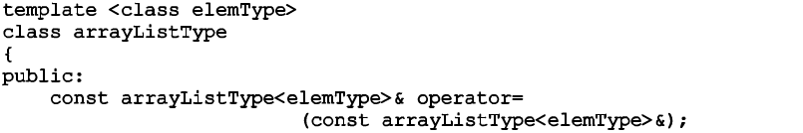
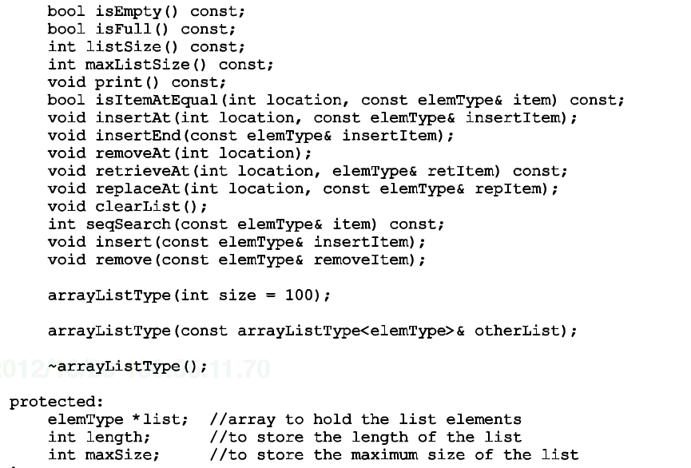
Data Structures Using C++ 2E

Slide 6
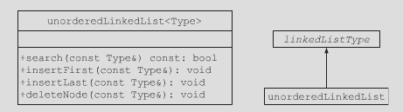
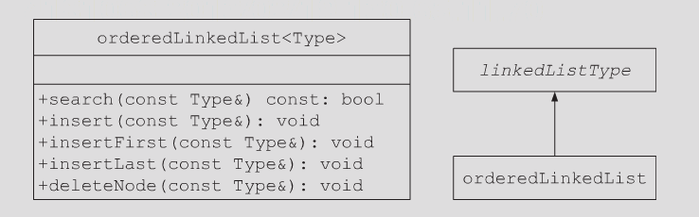
Data Structures Using C++ 2E

Slide 7
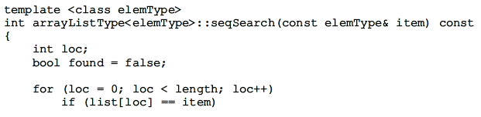

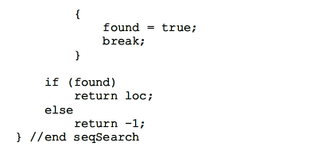
Data Structures Using C++ 2E

Slide 8
Sequential Search Analysis
Examine effect of for loop in seqSearch of Array-based lists (page 499)
Different programmers might implement same algorithm differently
  Number of key comparisons: typically the same
Computer speed affects performance
  Does not affect the number of key comparisons
Exercise: recursive sequential search
Data Structures Using C++ 2E

Slide 9
Sequential Search Analysis (cont’d.)
Sequential search algorithm performance
  Examine worst case and average case
  Count number of key comparisons
Unsuccessful search
  Search item not in list
  Make n comparisons
Successful search – depending on the location
  Best case: make one key comparison
  Worst case: algorithm makes n comparisons
Data Structures Using C++ 2E

Slide 10
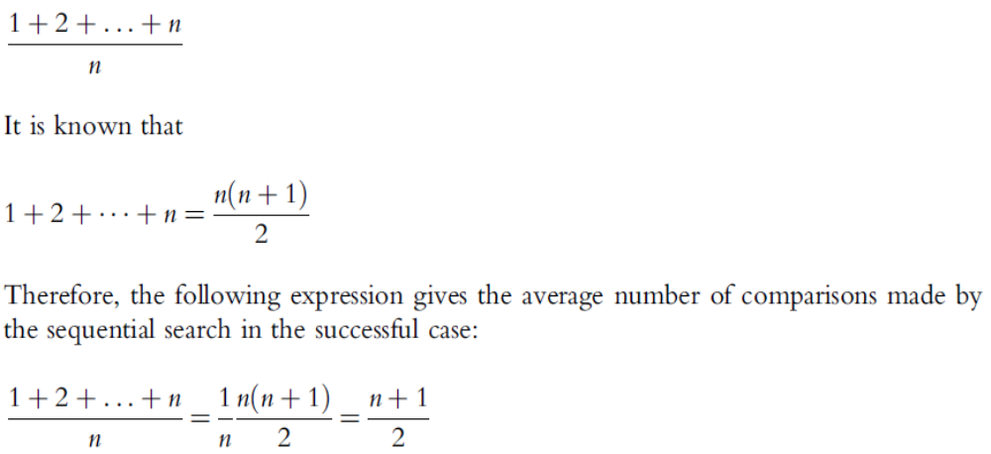
Sequential Search Analysis (cont’d.)
Determining the average number of comparisons
  Consider all possible cases
  Find number of comparisons for each case
  Add number of comparisons, divide by number of cases
O(n)
Data Structures Using C++ 2E

Slide 11
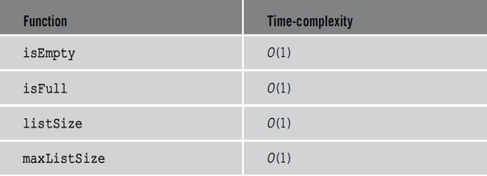
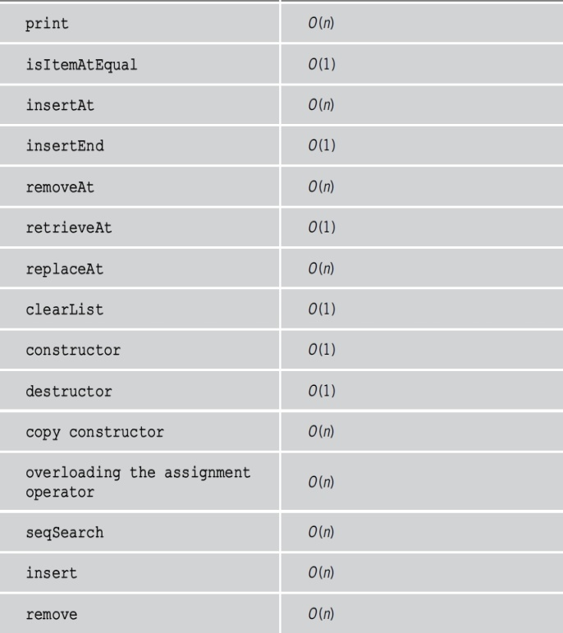
Sequential Search Analysis (cont’d.)
TABLE 3-1 Time complexity of array-based list operations
Data Structures Using C++ 2E

Slide 12
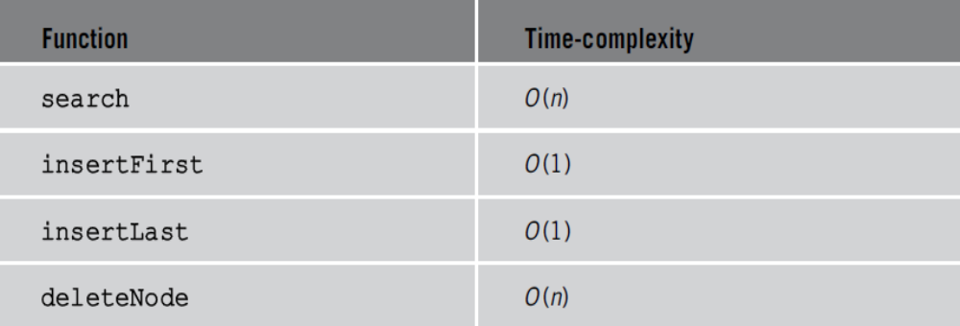
Sequential Search Analysis (cont’d.)
TABLE 5-7 Time-complexity of the operations of the
class unorderedLinkedList
Data Structures Using C++ 2E

Slide 13
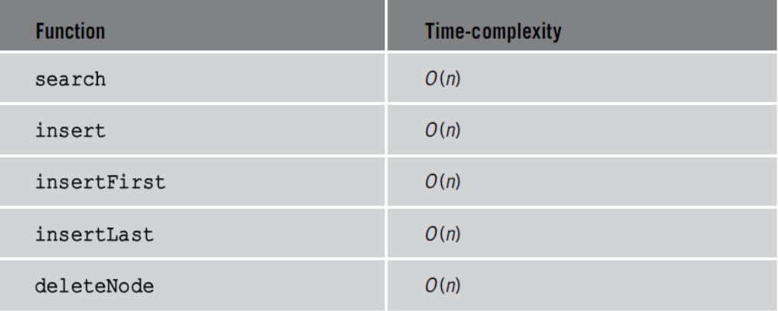
Sequential Search Analysis (cont’d.)
TABLE 5-8 Time-complexity of the operations of
the class orderedLinkedList
Can we do better?
Data Structures Using C++ 2E

Slide 14
Ordered Lists
Elements ordered according to some criteria
  Usually ascending order
Operations
  Same as those on an unordered list
    Determining if list is empty or full, determining list length, printing the list, clearing the list
Defining ordered list as an abstract data type (ADT)
  Use inheritance to derive the class to implement the ordered lists from arrayListType or linkedListType
Data Structures Using C++ 2E

Slide 15
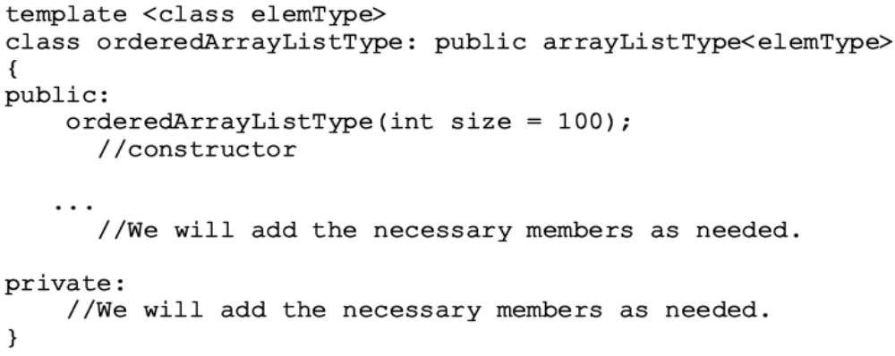
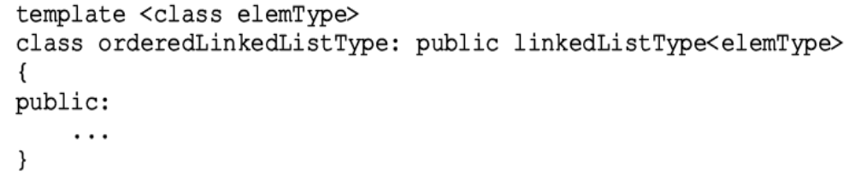
Ordered Lists (cont’d.)
Data Structures Using C++ 2E

Slide 16
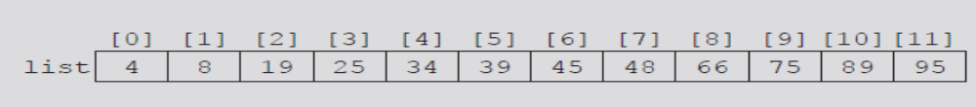
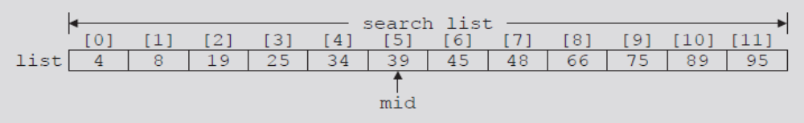
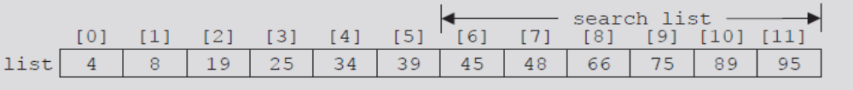
Binary Search
Performed only on ordered lists
divide-and-conquer technique
FIGURE 9-1 List of length 12. Searching for 75 in the list
FIGURE 9-2 Search list: list[0]...list[11]
FIGURE 9-3 Search list: list[6]...list[11]
Data Structures Using C++ 2E

Slide 17
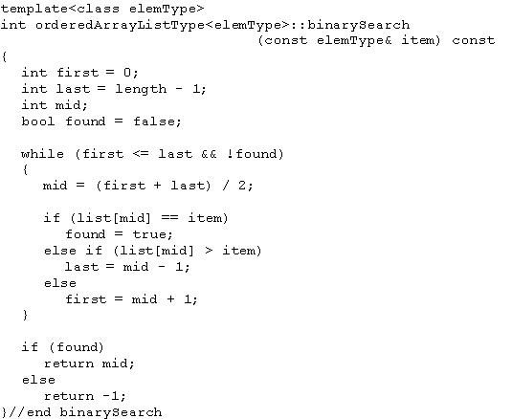
Binary Search (cont’d.)
C++ function implementing binary search algorithm
Each iteration:
Unsuccessful case: 2 key comparisons
Successful case: 1 key comparison
Data Structures Using C++ 2E

Slide 18

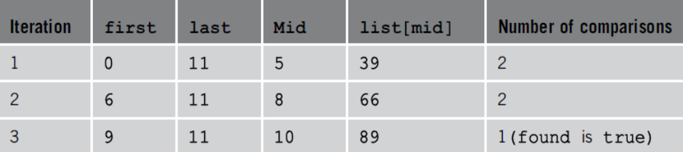
Binary Search (cont’d.)
Example 9-1. Searching for 89
FIGURE 9-4 Sorted list for a binary search
TABLE 9-1 Values of first, last, and mid and the number of comparisons for search item 89
Data Structures Using C++ 2E

Slide 19
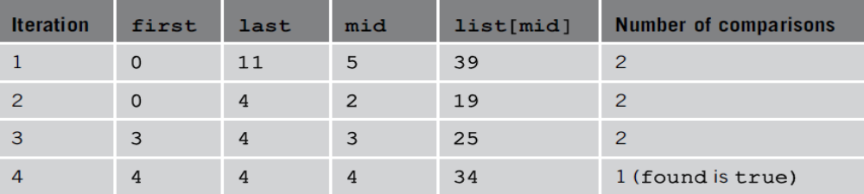
Binary Search (cont’d.)
Searching for 34
FIGURE 9-4 Sorted list for a binary search
TABLE 9-2 Values of first, last, and mid and the
number of comparisons for search item 34
Data Structures Using C++ 2E

Slide 20
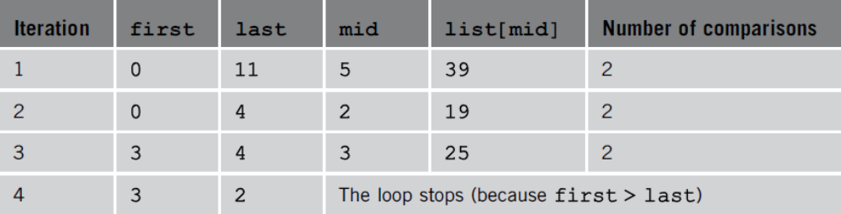
Binary Search (cont’d.)
Searching for 22
FIGURE 9-4 Sorted list for a binary search
TABLE 9-3 Values of first, last, and mid and the number of comparisons for search item 22
Data Structures Using C++ 2E

Slide 21
Insertion into an Ordered List
After insertion: resulting list must be ordered
  Find place in the list to insert item
    Use algorithm similar to binary search algorithm
  Slide list elements one array position down to make room for the item to be inserted
  Insert the item
    Use function insertAt of the class arrayListType
Data Structures Using C++ 2E

Slide 22
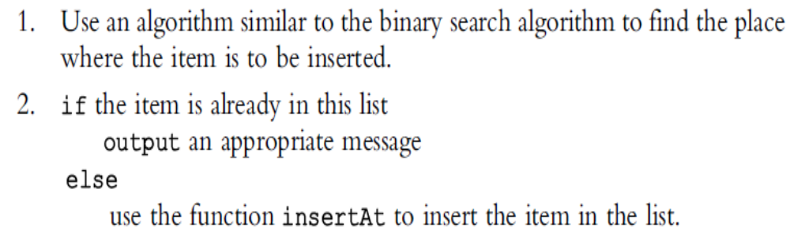
Insertion into an Ordered List (cont’d.)
Algorithm to insert the item
Function insertOrd implements algorithm
Data Structures Using C++ 2E

Slide 23
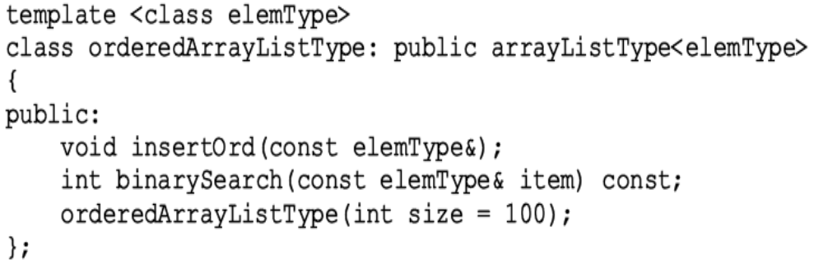
Insertion into an Ordered List (cont’d.)
Add binary search algorithm and the insertOrd algorithm to the class orderedArrayListType
Data Structures Using C++ 2E

Slide 24
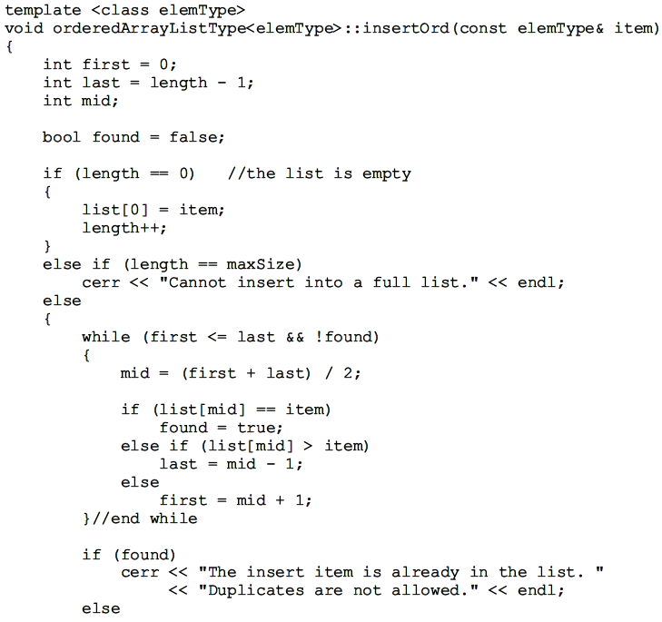
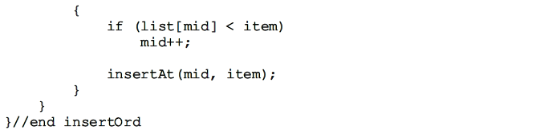
Why?

Slide 25
Insertion into an Ordered List (cont’d.)
class orderedArrayListType
  Derived from class arrayListType
  List elements of orderedArrayListType
    Ordered
Must override functions insertAt and insertEnd of class arrayListType in class orderedArrayListType
  If these functions are used by an object of type orderedArrayListType, list elements will remain in order
Data Structures Using C++ 2E

Slide 26
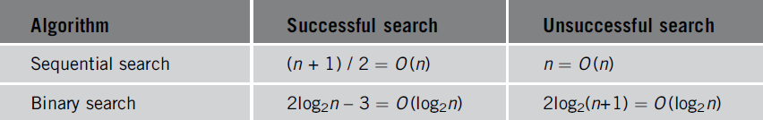
Insertion into an Ordered List (cont’d.)
Can also override function seqSearch
  Perform sequential search on an ordered list
    Takes into account that elements are ordered
Exercise: recursive binary search
TABLE 9-4 Number of comparisons for a list of length n
Data Structures Using C++ 2E

Slide 27
Lower Bound on Comparison-Based Search Algorithms
Comparison-based search algorithms
  Sequential search: order n
  Binary search: order log₂n
Theorem: # of comparison needed for any comparison-based search algorithm >= log₂(n+1)
Corollary: binary search is the optimal worst-case algorithm for solving comparison-based search problem
Devising a search algorithm with order less than log₂n
  Cannot be comparison based
Data Structures Using C++ 2E

Slide 28
Hashing
Algorithm of order one (on average)
Requires data to be specially organized
  Hash table
    Helps organize data
    Stored in an array
    Denoted by HT
  Hash function
    Arithmetic function denoted by h
    Applied to key X
    Compute h(X): read as h of X
    h(X) gives address of the item
Data Structures Using C++ 2E

Slide 29
Hashing (cont’d.)
Organizing data in the hash table
  Store data within the hash table (array)
  Store data in linked lists
Hash table HT divided into b buckets
  HT[0], HT[1], . . ., HT[b – 1]
  Each bucket capable of holding r items
  Follows that br = m, where m is the size of HT
  Generally r = 1
    Each bucket can hold one item
The hash function h maps key X onto an integer t
  h(X) = t, such that 0 <= h(X) <= b – 1
Data Structures Using C++ 2E

Slide 30
Hashing (cont’d.)
See Examples 9-2 and 9-3
Synonym
  Occurs if h(X₁) = h(X₂)
    Given two keys X₁ and X₂, such that X₁ ≠ X₂
Overflow
  Occurs if bucket t full
Collision
  Occurs if h(X₁) = h(X₂)
    Given X₁ and X₂ non-identical keys
Data Structures Using C++ 2E

Slide 31
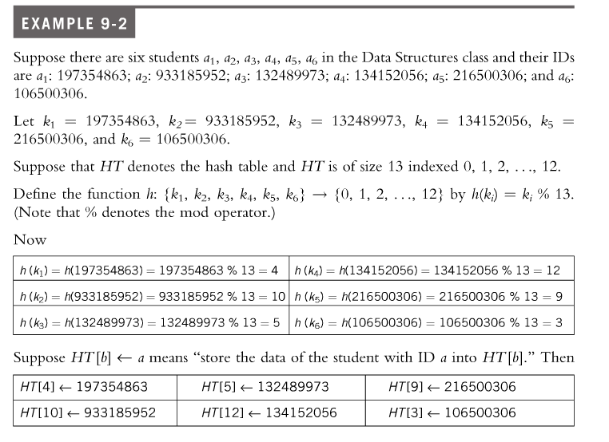
Data Structures Using C++ 2E

Slide 32
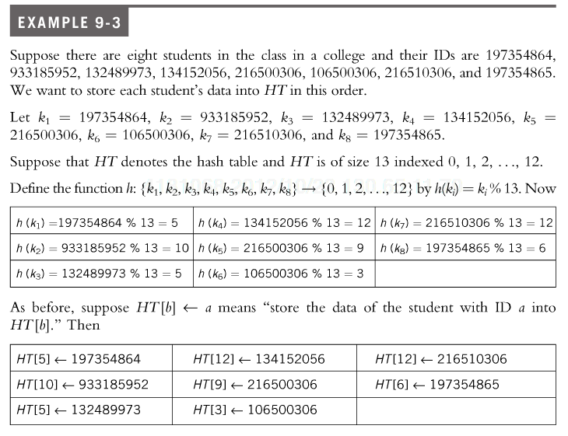
Data Structures Using C++ 2E
Notes:
Did you notice anything strange? Two keys hash into the same hash location

Slide 33
Hashing (cont’d.)
Overflow and collision occur at same time
  If r = 1 (bucket size = one)
Choosing a hash function
  Main objectives
    Choose an easy to compute hash function
    Minimize number of collisions
If HTSize denotes the size of hash table (array size holding the hash table)
  Assume bucket size = one
    Each bucket can hold one item
    Overflow and collision occur simultaneously
Data Structures Using C++ 2E

Slide 34
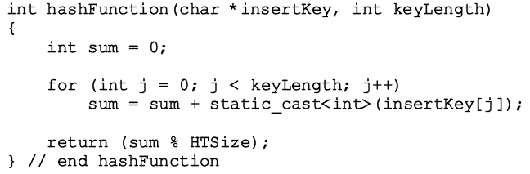
Hash Functions: Some Examples
Mid-square
  Compute by squaring the key, then using the appropriate number of bits from the middle, which usually depend on all characters of the key
Folding
  Keys are divided into equal parts, except the last parts, then add all the parts
Division (modular arithmetic)
  In C++
    h(X) = i_{X} % HTSize;
  C++ function
Data Structures Using C++ 2E
Notes:
In division hash, the input key is first converted into an integer and then modulo the hash size

Slide 35
Collision Resolution
Desirable to minimize number of collisions
  Collisions unavoidable in reality
    Hash function always maps a larger domain onto a smaller range
Resize HT: rehash existing items in HT
Collision resolution technique categories
  Open addressing (closed hashing)
    Data stored within the hash table
  Chaining (open hashing)
    Data organized in linked lists
    Hash table: array of pointers to the linked lists
HTSize > # of items
HTSize can be smaller than # of items
Data Structures Using C++ 2E

Slide 36
Collision Resolution: Open Addressing
Data stored within the hash table
  For each key X, h(X) gives index in the array
    Where item with key X likely to be stored
Linear probing
  Constant 1
  Constant c
Random probing
Rehashing
Quadratic Probing
Double hashing
Data Structures Using C++ 2E

Slide 37
Open Addressing: Linear Probing
Starting at location t
  Search array sequentially to find next available slot
Assume circular array
  If lower portion of array full
    Can continue search in top portion of array using mod operator
  Starting at t, check array locations using probe sequence
    t, (t + 1) % HTSize, (t + 2) % HTSize, . . ., (t + j) % HTSize
Data Structures Using C++ 2E

Slide 38
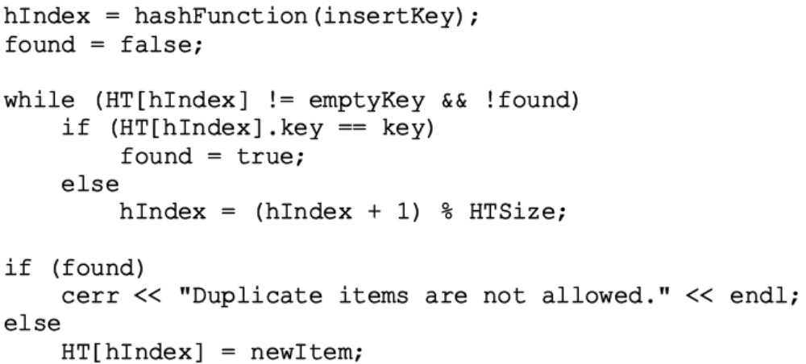
Open Addressing: Linear Probing (cont’d.)
The next array slot is given by
  (h(X) + j) % HTSize where j is the j^{th} probe
See Example 9-4
C++ code implementing linear programming
Data Structures Using C++ 2E

Slide 39
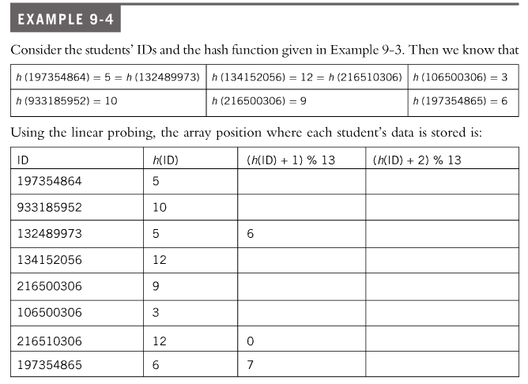
Data Structures Using C++ 2E

Slide 40

Open Addressing: Linear Probing (cont’d.)
Causes clustering (primary clustering)
  More and more new keys would likely be hashed to the array slots already occupied
FIGURE 9-5 Hash table of size 20
Slot 9 will be occupied if h(X) = 6, 7, 8, or 9. Probability = 4/20
FIGURE 9-6 Hash table of size 20 with certain positions occupied
Probability that slot 14 will be occupied = 9/20
FIGURE 9-7 Hash table of size 20 with certain positions occupied
Data Structures Using C++ 2E
Notes:
In figure 9-6, the probability that slot 9 will be occupied next is 4/20, while the probability of slot 16 being occupied will be 1/20
In Figure 9-7, the probability of slot 14 to be occupied is 9/20, while the probability of slot 16 to be occupied is 1/20

Slide 41
Open Addressing: Linear Probing (cont’d.)
Improving linear probing
  Skip array positions by fixed constant (c) instead of one
  New hash address: (h(X) + i * c) % HTSize
    If c = 2 and h(X) = 2k, i.e., h(X) even
      Only even-numbered array positions visited
    If c = 2 and h(X) = 2k + 1, i.e., h(X) odd
      Only odd-numbered array positions visited
    To visit all the array positions
      Constant c must be relatively prime to HTSize
Data Structures Using C++ 2E
Notes:
Two integers are relatively prime if they share no common positive factors (divisors) except 1.
Greatest common divisor (gcd) is 1.
e.g., 6 and 35

Slide 42
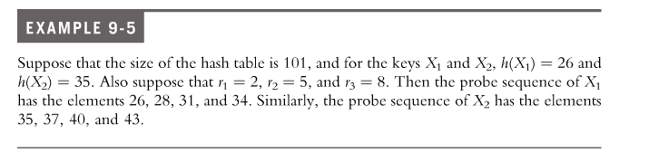
Open Addressing: Random Probing
Uses random number generator to find next available slot
  i^{th} slot in probe sequence: (h(X) + r_{i}) % HTSize
    Where r_{i} is the i^{th} value in a random permutation of the numbers 1 to HTSize – 1
  All insertions, searches use same random numbers sequence
  Pros: Reduces primary clustering
Why?
Data Structures Using C++ 2E
Notes:
Why: we need to search item later. Need to know the exact sequence in order to search.

Slide 43
Open Addressing: Rehashing
If collision occurs with hash function h
  Use a series of hash functions: h₁, h₂, . . ., h_{s}
  If collision occurs at h(X)
    Examine array slots h_{i}(X), 1 <= i <= s
Data Structures Using C++ 2E

Slide 44
Open Addressing: Quadratic Probing
Suppose
  Item with key X hashed at t , i.e., h(X) = t and 0 <= t <= HTSize – 1
  Position t already occupied
Starting at position t
  Linearly search array at locations
    (t + 1)% HTSize,
    (t + 2² ) % HTSize = (t + 4) %HTSize,
    (t + 3²) % HTSize = (t + 9) % HTSize, . . .,
    (t + i²) % HTSize
Probe sequence: t, (t + 1) % HTSize, (t + 2²) % HTSize, (t + 3²) % HTSize, . . ., (t + i²) % HTSize
Data Structures Using C++ 2E

Slide 45
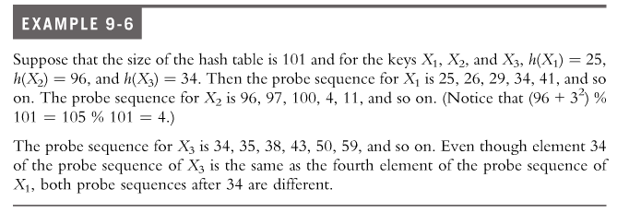
Data Structures Using C++ 2E

Slide 46
Open Addressing: Quadratic Probing (cont’d.)
See Example 9-6
Pros: reduces primary clustering
Cons: does not probe all positions in the table
  When HTSize is a prime, probes about half the table before repeating probe sequence
  Collisions can be resolved if HTSize is a prime at least twice the number of items
  Considerable number of probes
    Assume full table
    Stop insertion (and search)
Data Structures Using C++ 2E

Slide 47
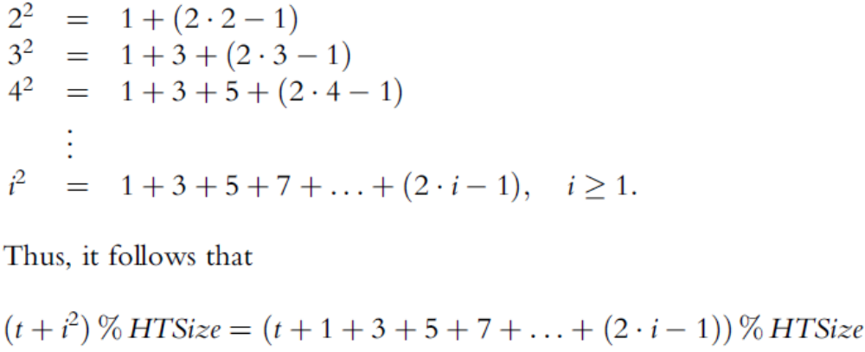
Open Addressing: Quadratic Probing (cont’d.)
Generating the probe sequence
Why?
Data Structures Using C++ 2E
Notes:
Why do we express it this way? To save computation when moving from (t+i^2) mod HTSize = (t+(i+1)^2) mod HTSize

Slide 48
Open Addressing: Quadratic Probing (cont’d.)
Consider probe sequence
  t, t +1, t + 2², t + 3², . . . , (t + i²) % HTSize
  C++ code computes i^{th} probe
    (t + i²) % HTSize
    int inc = 1;
    int pCount = 0;
    while (pCount < i) {
    t = (t + inc) % HTSize;
    inc = inc + 2;
    pCount++;
    }
Data Structures Using C++ 2E

Slide 49
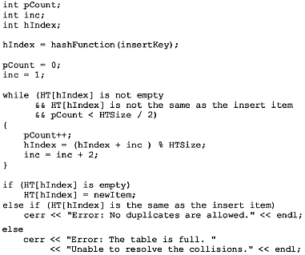
Open Addressing: Quadratic Probing (cont’d.)
Pseudocode implementing quadratic probing
Data Structures Using C++ 2E

Slide 50
Open Addressing: Quadratic Probing (cont’d.)
Random, quadratic probings eliminate primary clustering
Secondary clustering
  If two non-identical keys (X₁ and X₂) hashed to same home position (h(X₁) = h(X₂))
    Same probe sequence followed for both keys
  If hash function causes a cluster at a particular home position
    Cluster remains under these probings
    Not original key
Data Structures Using C++ 2E

Slide 51
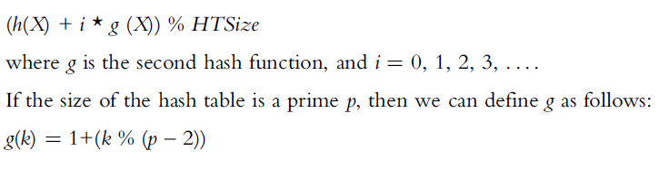
Open Addressing: Double hashing
Solve secondary clustering with double hashing
  Use linear probing
    Increment value: function of key
  If collision occurs at h(X)
    Probe sequence generation
See Examples 9-7 and 9-8
Data Structures Using C++ 2E

Slide 52
Deletion: Open Addressing
  Problem: two keys R and R’ hash to the same HT index. What happens when we delete R and then search for R’
  Same probe sequence
  R cannot be deleted by marking its position as empty in HT
Solution: Use two arrays (of the same size)
  Array one: stores the data
  Array two: indexStatusList
    Indicates whether a position in hash table free (0), occupied (1), used previously (-1)
See code on pages 521 and 522
  Class template implementing hashing as an ADT
  Definition of function insert
Data Structures Using C++ 2E
Notes:
If we mark R’s position as empty, then search for R’ will stop at the empty slot
So R’ should be marked free, occupied, and used previously
indexStatusList 0 – free, 1 – occupied, -1 – deleted.

Slide 53
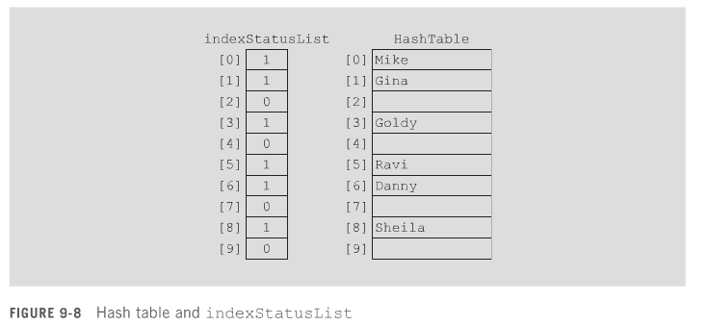
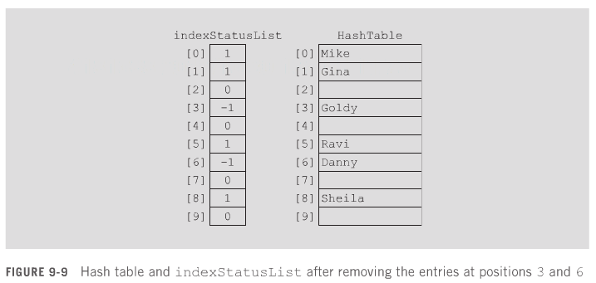
After Goldy is removed
After Danny is removed
Data Structures Using C++ 2E

Slide 54
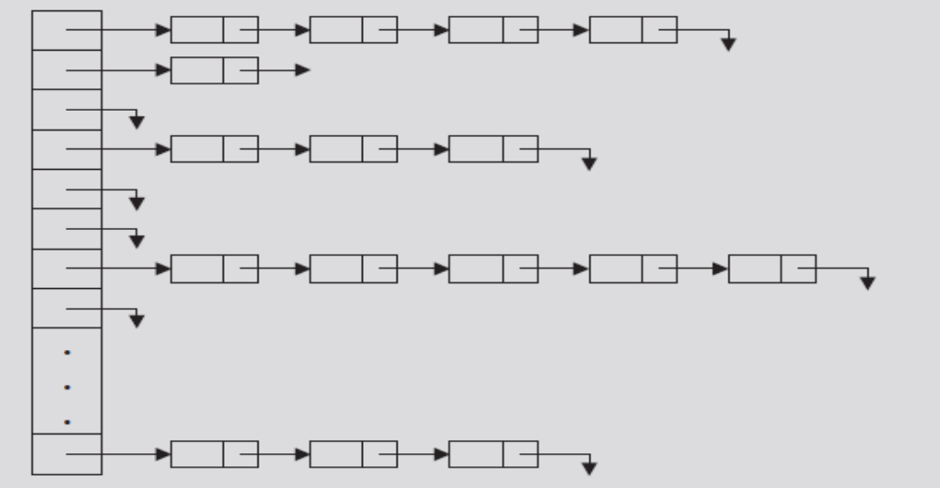
Collision Resolution: Chaining (Open Hashing)
Hash table HT: array of pointers
  For each j, where 0 <= j <= HTsize -1
    HT[j] is a pointer to a linked list
    Hash table size (HTSize): less than or equal to the number of items
FIGURE 9-10 Linked hash table
Data Structures Using C++ 2E

Slide 55
Collision Resolution: Chaining (cont’d.)
Item insertion and collision
  For each key X (in the item)
    First find h(X) = t, where 0 <= t <= HTSize – 1
    Item with this key inserted in linked list pointed to by HT[t]
  For nonidentical keys X₁ and X₂
    If h(X₁) = h(X₂): Items with keys X₁ and X₂ inserted in same linked list
    Collision handled quickly, effectively
Data Structures Using C++ 2E

Slide 56
Collision Resolution: Chaining (cont’d.)
Search
  Determine whether item R with key X is in the hash table
    First calculate h(X)
  Example: h(X) = T
    Linked list pointed to by HT[t] searched sequentially, or binary search
Deletion
  Delete item R from the hash table
    Search hash table to find where in a linked list R exists
    Adjust pointers at appropriate locations
    Deallocate memory occupied by R
Data Structures Using C++ 2E

Slide 57
Collision Resolution: Chaining (cont’d.)
Overflow: no longer a concern
  Data stored in linked lists
  Memory space to store data allocated dynamically
Hash table size
  No longer needs to be greater than number of items
Hash table less than the number of items
  Some linked lists contain more than one item
  Good hash function has average linked list length still small (search is efficient)
Data Structures Using C++ 2E

Slide 58
Collision Resolution: Chaining (cont’d.)
Advantages of chaining
  Item insertion and deletion: straightforward
  Efficient hash function
    Few keys hashed to same home position
    Short linked list (on average)
      Shorter search length
    If item size is large
      Saves a considerable amount of space
Data Structures Using C++ 2E

Slide 59
Collision Resolution: Chaining (cont’d.)
Disadvantage of chaining
  Small item size wastes space
Example: 1000 items each requires one word of storage
  Chaining
    Requires 3000 words of storage
  Quadratic probing
    If hash table size twice number of items: 2000 words
    If table size three times number of items
      Keys reasonably spread out
      Results in fewer collisions
Data Structures Using C++ 2E
Notes:
Why needing 3000 words of storage? 1000 word of hash table, 1000 word for items, and 1000 word for links.
Talk about complexity:
#of probes in an Unsuccessful search: 1+n/m, where n is the #entries in the hash table, and m is #slots in the hash table.

Slide 60
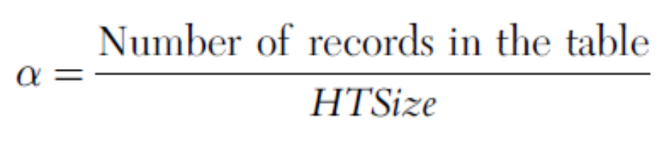
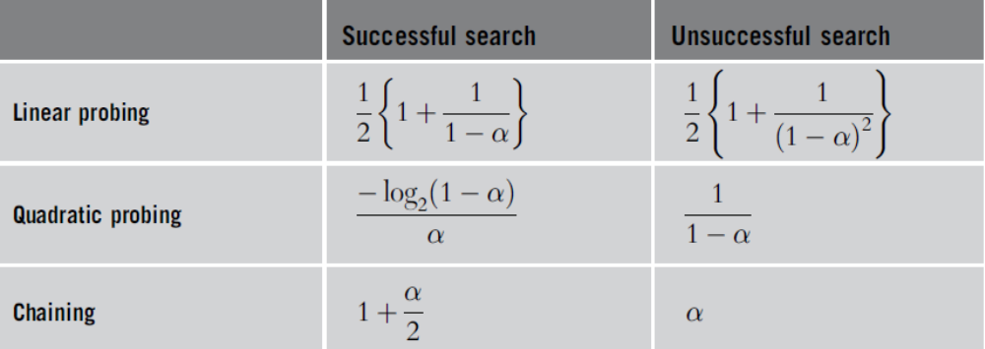
Hashing Analysis
Load factor
  Parameter α
TABLE 9-5 Average number of comparisons in hashing
Data Structures Using C++ 2E

Slide 61
Summary
Sequential search
  Order n
Ordered lists
  Elements ordered according to some criteria
Binary search
  Order log₂n
Search analysis
  Review number of key comparisons
  Worst case, best case, average case
Data Structures Using C++ 2E

Slide 62
Summary (cont’d.)
Hashing: Data organized using a hash table
Hash functions
Primary/secondary clustering
Collision resolution technique categories
  Open addressing (closed hashing)
    Linear probing
    Random probing
    Rehashing
    Quadratic Probing
    Double hashing
  Chaining (open hashing)
Data Structures Using C++ 2E

Slide 63
Self Exercises
Programming Exercises: 1, 2, 3, 6, 8
Data Structures Using C++ 2E

